Slide 1
Encryption
using One way function generator
using Double pendulum

Slide 2

Chaotic
Double Pendulums
Why ?
Graph
About
Derivation
It’s motion

Slide 3
What is Double Pendulum ?
A double pendulum is a system consisting of two pendulums connected end to end, which exhibits chaotic behavior and is a classic example of chaos theory. Although, the construction of a double pendulum is relatively simple, its motion is complex and fascinating.
Graph
About
Why ?
It’s motion
Derivation

Slide 4
The Motion Of A Double Pendulum
For smaller release angles, a double pendulum performs Simple Harmonic Motion, which is predictable, like a simple pendulum with smaller release angles. However, the motion becomes unpredictable for larger release angles due to the system's sensitivity to initial conditions. The trajectory goes frenzy as time passes.
A system of ordinary differential equations in Lagrangian mechanics describes the system's motion.
Why ?
Graph
About
Derivation
It’s motion

Slide 5
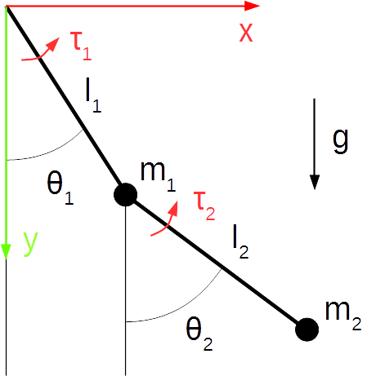
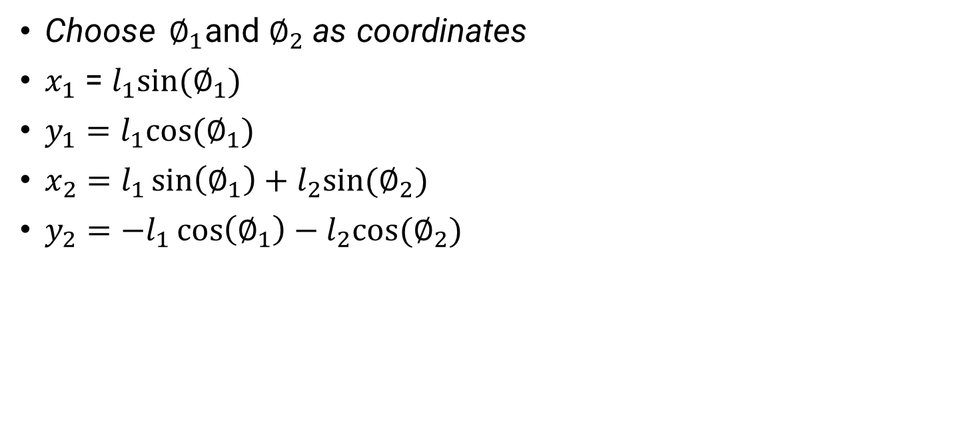
Deriving equations of motion
Choose $∅_{1}$and $∅_{2}$as coordinates
$x_{1}$ = $l_{1}sin⁡(∅_{1})$
$y_{1}=l_{1}cos⁡(∅_{1})$
$x_{2}=l_{1}\sin\left(∅_{1}\right)+l_{2}sin⁡(∅_{2})$
$y_{2}=−l_{1}\cos\left(∅_{1}\right)−l_{2}cos⁡(∅_{2})$
Why ?
history
Graph
Derivation
about

Slide 6
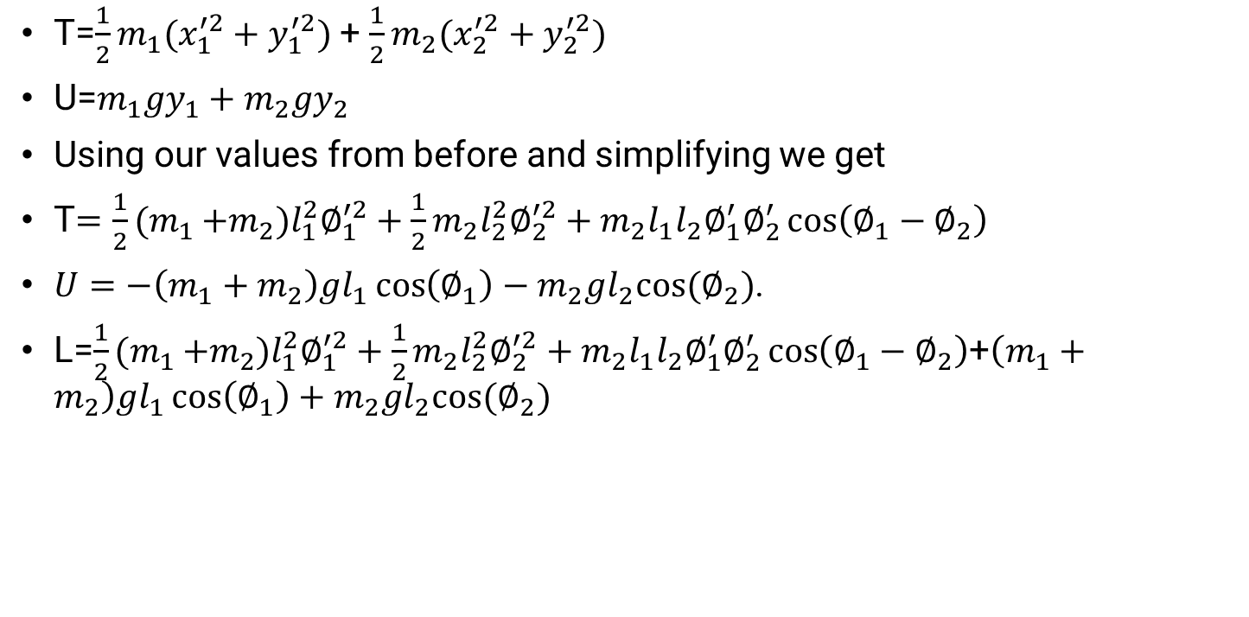
Deriving equations of motion
T=$\frac{1}{2}m_{1}(x_{1}^{′2}+y_{1}^{′2})$ + $\frac{1}{2}m_{2}(x_{2}^{′2}+y_{2}^{′2})$
U=$m_{1}gy_{1}+m_{2}gy_{2}$
Using our values from before and simplifying we get
T$=\frac{1}{2}{(m}_{1 }+m_{2})l_{1}^{2}∅_{1}^{′2}+\frac{1}{2}m_{2}l_{2}^{2}∅_{2}^{′2}+m_{2}l_{1}l_{2}∅_{1}^{′}∅_{2}^{′}\cos\left(∅_{1}−∅_{2}\right)$
$U=−\left(m_{1}+m_{2}\right)gl_{1}\cos\left(∅_{1}\right)−m_{2}gl_{2}cos⁡(∅_{2})$.
L=$\frac{1}{2}{(m}_{1 }+m_{2})l_{1}^{2}∅_{1}^{′2}+\frac{1}{2}m_{2}l_{2}^{2}∅_{2}^{′2}+m_{2}l_{1}l_{2}∅_{1}^{′}∅_{2}^{′}\cos\left(∅_{1}−∅_{2}\right)$+$\left(m_{1}+m_{2}\right)gl_{1}\cos\left(∅_{1}\right)+m_{2}gl_{2}cos⁡(∅_{2})$
Why ?
history
Graph
Derivation
about

Slide 7
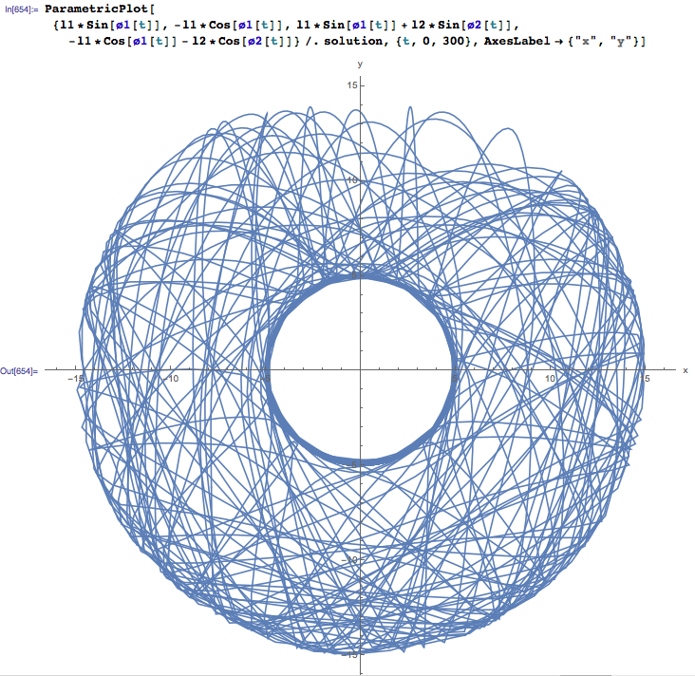
Why ?
Graph
history
timeline
about
https://www.youtube.com/watch?v=QXf95_EKS6E

Slide 8
Why is it chaotic then ?
If we have the equations of motion, why would the system be unpredictable?
Just solve the equations and we can predict the motion of the pendulums, right?
The trouble is that the system of the double pendulum is extremely dependent on initial conditions. If we cannot determine the initial conditions with 100% certainty (we mean it to the thousandth of a radian), we cannot predict the exact behavior of the system.
Since it is impossible to achieve that level of certainty, we cannot predict the motion of a double pendulum. Two double pendulums released from the simultaneously with a slight variation in their initial conditions, will translate into a dramatic change in trajectory in a very short time. The variation in their paths will increase rapidly and exponentially.
We use this property to build a key for cryptosystem out of it.
Why ?
history
teams
timeline
about

Slide 9
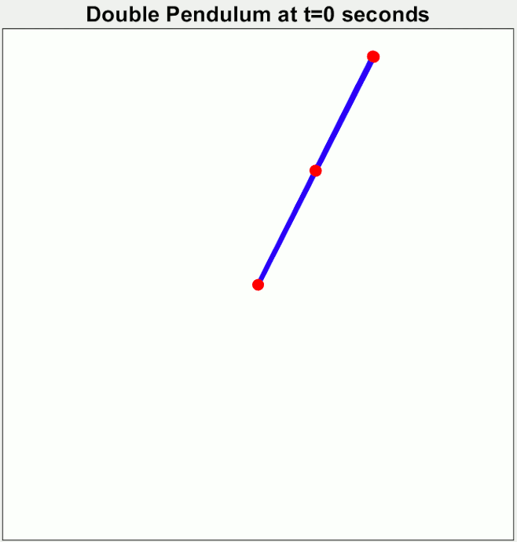
Difference in path traced by multiple pendulums with slight difference in initial state of release.
Why ?
history
teams
timeline
about
https://en.wikipedia.org/wiki/File:Demonstrating_Chaos_with_a_Double_Pendulum.gif

Slide 10





Why use chaos maps for image encryption
Binarization of the pendulum state
Chaos map using double pendulum for encryption and decryption
Key Generation
Encryption and Decryption Process
Performance Analysis

Slide 11
What is chaos map? Double Pendulum as a chaos map
The chaotic map is a mathematical function that generates highly nonlinear and unpredictable real sequence which is very sensitive to initial conditions i.e., seed value. The above double pendulum system of equations is one such example of a complicated chaotic map. Although it is unpredictable, it is not random.
Double pendulum motion as described in earlier slides is a perfect example of chaos map. Other example of chaos map are recurrence logistic map, Lorentz system, etc.
Double pendulum generates floating point value of various different parameters which we would want to consider, like the angular velocity, or the angular displacement from the vertical or the X-Y coordinates.

Slide 12
Why use chaos maps for image encryption?
Images have intrinsic features such as bulk data capacity and high correlation among adjacent pixels.
Traditional encryption algorithms such as DES, AES, and RSA are unsuitable for practical image encryption, because of above mentioned features, especially under online communication scenarios, also the speed of encryption required. This is because traditional encryption methods are key-sensitive.
Chaos-based algorithms have been studied for image encryption due to their ability to generate complex and unpredictable behavior from simple equations. These algorithms use chaotic maps to shuffle and mix the pixels of an image, making it difficult for unauthorized users to decipher the original image.
Unlike, classical key sensitive cryptographic algorithms which shuffle and diffuse data by rounds of encryption, chaotic maps spread the initial region over the entire phase space via iterations.

Slide 13
STEP BY STEP DESCRIPTION
But how to make an encryption system
out of this ??
STEP BY STEP DESCRIPTION

Slide 14
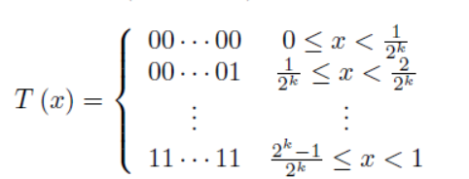
Key Generation
A key is required to perform the encryption process. A chaotic map can serve as a good encryption key.
The benefit of such double pendulum chaotic map is that the initial conditions need to be known with extreme precision in order to recreate the sequence, which is required for correct decryption.
This property of the chaos maps is useful in visual cryptography to generate long key sequences from a seed key value with a high level of security in the fact that the key needs to be very precisely known for decryption.
A set of initial condition values can be used to generate a long sequence of seemingly random real numbers. These real numbers can then be converted to binary streams using a thresholding function.
Threshold function is like a step function defined as :

Slide 15
Key Generation
However, the generated key sequence using threshold function will have a considerable amount of correlation between the bits to be secure. This can be exploited to attack the system.
This can be countered by using Linear Feedback Shift Register (LFSR). Each individual bit in LFSR will indicate one state of the LFSR. Thus, for k bits long bitstream, we use an LFSR with k states. A k-state LFSR will give rise to a 2^k bit long bit-sequence with a very low correlation value.
Thus, we can generate extremely long round key sequences using the chaos map and LFSR combination. This, in turn, will ensure a high level of security for the visual cryptography process

Slide 16
How to make a Key?
A combination of initial conditions [Angular position and Angular velocity] is chosen for the double pendulum system.
The system is simulated using the initial conditions as seed value to generate a series of real values based on the state of the system, which will be unique for all different initial seed conditions.
A real-valued sequence is converted to a binary stream by using a thresholding function. This function divides the range of sequence amplitude into 2b levels and assigns each value to a corresponding level, which is then mapped to a binary string. The resulting binary stream will have a length of b. Thus, the sequence is converted into a binary sequence of length k.
This binary sequence is provided as seed value for a k - state LFSR. This LFSR returns a 2^k bit long bit-sequence which can then be used for encryption.

Slide 17
Plain Text and Cipher Text
In visual cryptography, any form of visual data, like text, image, etc., is converted into a sequence of pixel values. These pixel values are then converted into binary form to generate a binary sequence for encoding.
During decryption, the decrypted binary sequence is used to generate an image to be rendered at the end.
There is a simple transition back and forth from the image to binary sequence and vice-versa.

Slide 18
Encryption Process [Highly inspired from AES]
Taking inspiration from the AES encryption process, we can have multiple rounds of encryption each involving three sub-processes of key addition, column and shuffling, and row rotation on the pixel matrix of the image.
As the name suggests, the key addition step will simply have the XOR (addition modulo 2) of the key and the pixels values.
In column shuffling, the image matrix will be divided into column vectors which will be matched to one of its permutations.
In row shuffling, the rows of the matrix will be left rotated in increasing order (in a similar fashion to AES), i.e., the ith column can be left shifted by i positions (assuming 0-based indexing).
The rounds can be repeated for several times to ensure that the pixels are properly diffused.

Slide 19
The Decryption Process
The decryption of the image will be simply the inversion of the steps followed in encryption.
First we right-rotate the ith pixel row by i positions.
Then, we unshuffled the column based on the inverse of the permutation used in encryption.
Finally, we again XOR with the key [generated using initial seed and chaos map] to undoing the round completely.
The process can be repeated for the same number of rounds as followed for the encryption to get the decrypted image.

Slide 20
Performance evaluation
The research paper we referred to suggests a good level of performance in all the aspects including. More on this, shall be evaluated after developing the system and doing related study.
Performance Metrices considered:
Entropy
Correlation coefficient
Sensitivity wrt. Key
Histogram band
An additional utility to convert the image to text or any other format the data was originally in can be included to get the actual data back.
That is, this method is expandable to multiple type of data, because at last the data can be converted into binary form and retrieved from binary form.

Slide 21
Reference Research Papers
Liu, Shubo, Jing Sun, and Zhengquan Xu. "An Improved Image Encryption Algorithm based on Chaotic System." J. Comput. 4.11 (2009): 1091-1100.
Shruthi, K. M., S. Sheela, and S. V. Sathyanarayana. "Image encryption scheme with key sequences based on chaotic functions." 2014 International Conference on Contemporary Computing and Informatics (IC3I). IEEE, 2014.
Stachowiak, Tomasz, and Toshio Okada. "A numerical analysis of chaos in the double pendulum." Chaos, Solitons & Fractals 29.2 (2006): 417-422.

Slide 22
01
Dhruv Chokshi
202001049
202001052
02
Kandarp Devmurari
The Team
03
202001055
Pranav Patil
202001057
04
Krupal Shah
05
202001110
Vihar Shah [GR]

